Slide 1


 | Nitte Meenakshi Institute of Technology (AN AUTONOMOUS INSTITUTION AFFILIATED TO VISVESVARAYA TECHNOLOGICAL UNIVERSITY, BELGAUM) PB No. 6429, Yelahanka, Bangalore 560-064, Karnataka Telephone: 080- 22167800, 22167860, Fax: 080 - 22167805
Department of Computer Science and Engineering
URBAN SOUND CLASSIFICATION
Presentation By:
Umang Kumar Harlalka (1NT18CS211)
Mukesh Goit (1NT19CS198)
Abhinash Prasad Sah (1NT18CS189)
AY 2021-2022

Slide 2
TABLE OF CONTENTS
 | Nitte Meenakshi Institute of Technology (AN AUTONOMOUS INSTITUTION AFFILIATED TO VISVESVARAYA TECHNOLOGICAL UNIVERSITY, BELGAUM) PB No. 6429, Yelahanka, Bangalore 560-064, Karnataka Telephone: 080- 22167800, 22167860, Fax: 080 - 22167805
Department of Computer Science and Engineering
Abstract
Introduction
Motivation
Problem Statement
Aims and objectives
Data set
Data preprocessing
Design
ANN Algorithm
Result
Conclusion
References
AY 2021-2022

Slide 3
Abstract
 | Nitte Meenakshi Institute of Technology (AN AUTONOMOUS INSTITUTION AFFILIATED TO VISVESVARAYA TECHNOLOGICAL UNIVERSITY, BELGAUM) PB No. 6429, Yelahanka, Bangalore 560-064, Karnataka Telephone: 080- 22167800, 22167860, Fax: 080 - 22167805
Department of Computer Science and Engineering
This learning activity project is a simple audio classification model based on machine learning and deep learning. We address the problem of classifying the type of sound based on short audio signals and their generated spectrograms, from labeled sounds belonging to 10 different classes during model training. In order to meet this challenge, we use a model based on Convolutional Neural Network (CNN),Artificial neural network(ANN) or KNN. The audio was processed with Mel-frequency Cepstral Coefficients (MFCC) into what's commonly known as Mel spectrograms, and hence, was transformed into an image. Our final CNN model achieved 91% accuracy on the testing datasets.
AY 2021-2022

Slide 4
Introduction
 | Nitte Meenakshi Institute of Technology (AN AUTONOMOUS INSTITUTION AFFILIATED TO VISVESVARAYA TECHNOLOGICAL UNIVERSITY, BELGAUM) PB No. 6429, Yelahanka, Bangalore 560-064, Karnataka Telephone: 080- 22167800, 22167860, Fax: 080 - 22167805
Department of Computer Science and Engineering
Sounds are the part of our daily lives, ranging from the daily conversations with people, the music we listen to, and all the other environmental sounds. Sound classification is a constantly developing area of research and is at the heart of a lot of advanced technologies including automatic speech recognition systems, security systems, and text-to-speech applications. Moreover, we know convolutional neural networks (CNNs) are widely used in image classification and they achieve significantly high accuracy, so we try to use this technique in a seemingly different field of audio classification, where discrete sounds happen over time. This project aims to build a deep learning powered audio classifier. The basic underlying problem is to be able to manipulate audio data and build a model to classify sounds. The project aims to leverage progress achieved in the deep learning field for speaker identification and recognition problems in order to perform accurately and improve to effectively assist users. The input of the algorithm used in this project is taken from the database of the Urban Sound Classification Challenge, which are short audio samples commonly found in an urban environment like children playing, street music, a car engine etc. The samples must first be pre-processed in order to extract the MFCC features of each audio signal. The MFCC features vector is used as an input for the CNN model for classification and to generate predictions.
AY 2021-2022

Slide 5
Motivation
 | Nitte Meenakshi Institute of Technology (AN AUTONOMOUS INSTITUTION AFFILIATED TO VISVESVARAYA TECHNOLOGICAL UNIVERSITY, BELGAUM) PB No. 6429, Yelahanka, Bangalore 560-064, Karnataka Telephone: 080- 22167800, 22167860, Fax: 080 - 22167805
Department of Computer Science and Engineering
Innovation and exploration of new technology has become a major influence in present era.
Various sound has been generated daily and used by us to classify the information and use it for the communication.
Study and exploration of sound classification using machine learning is our primary concern as it provides learning opportunity on currently developed technologies.
Using proper dataset of sounds generated in urban area, we intend to train and test our model for useful classification of various features of sound with maximum accuracy.
AY 2021-2022

Slide 6
Problem statement
 | Nitte Meenakshi Institute of Technology (AN AUTONOMOUS INSTITUTION AFFILIATED TO VISVESVARAYA TECHNOLOGICAL UNIVERSITY, BELGAUM) PB No. 6429, Yelahanka, Bangalore 560-064, Karnataka Telephone: 080- 22167800, 22167860, Fax: 080 - 22167805
Department of Computer Science and Engineering
This classification plays a key role in organising audio libraries by genre, improving recommendation algorithms, and discovering trends and listener preferences through data analysis.
Noise present in urban area provides sufficient data to train the model and test the accuracy of the model.
Development and research of a sound classification models will be helpful for various sectors i.e forensic, specially abled person and so on.
AY 2021-2022

Slide 7
Aims and objectives
 | Nitte Meenakshi Institute of Technology (AN AUTONOMOUS INSTITUTION AFFILIATED TO VISVESVARAYA TECHNOLOGICAL UNIVERSITY, BELGAUM) PB No. 6429, Yelahanka, Bangalore 560-064, Karnataka Telephone: 080- 22167800, 22167860, Fax: 080 - 22167805
Department of Computer Science and Engineering
To successfully classify various sounds that can be generated in urban city.
To identify particular entity by comparing its sound frequency.
To help specially abled people i.e. blind and deaf person.
To be helpful in forensic study and analysis.
AY 2021-2022

Slide 8
Data set
 | Nitte Meenakshi Institute of Technology (AN AUTONOMOUS INSTITUTION AFFILIATED TO VISVESVARAYA TECHNOLOGICAL UNIVERSITY, BELGAUM) PB No. 6429, Yelahanka, Bangalore 560-064, Karnataka Telephone: 080- 22167800, 22167860, Fax: 080 - 22167805
Department of Computer Science and Engineering
Link to dataset:
https://www.kaggle.com/chrisfilo/urbansound8k.
The dataset is a present wav file and contains 8732 entries of unique values. The dataset contains 8732 labeled sound excerpts (<=4s) of urban sound from 10 classes: air_conditioner, car_horn, children_playing, dog_bark, drilling, gunshot, engine, siren and street_music.
AY 2021-2022

Slide 9

Data preprocessing steps
 | Nitte Meenakshi Institute of Technology (AN AUTONOMOUS INSTITUTION AFFILIATED TO VISVESVARAYA TECHNOLOGICAL UNIVERSITY, BELGAUM) PB No. 6429, Yelahanka, Bangalore 560-064, Karnataka Telephone: 080- 22167800, 22167860, Fax: 080 - 22167805
Department of Computer Science and Engineering
The following steps will be performed in data pre-processing in our project:
Getting the data: We will be getting our data from the kaggle website and we will be using the data that they have collected in the form of csv files and wav files.
Import libraries: Then we will proceed by importing the necessary libraries to process our information which will be
Pandas: The last library is the Pandas library, which is one of the most famous Python libraries and used for importing and managing the datasets. It is an open-source data manipulation and analysis library. It will be imported as below:
AY 2021-2022

Slide 10

Data preprocessing steps
 | Nitte Meenakshi Institute of Technology (AN AUTONOMOUS INSTITUTION AFFILIATED TO VISVESVARAYA TECHNOLOGICAL UNIVERSITY, BELGAUM) PB No. 6429, Yelahanka, Bangalore 560-064, Karnataka Telephone: 080- 22167800, 22167860, Fax: 080 - 22167805
Department of Computer Science and Engineering
The following steps will be performed in data pre-processing in our project:
Import the dataset: Now we need to import the datasets which we have collected for our machine learning project. Now to import the dataset, we will use read_csv() function of pandas library, which is used to read a csv file and performs various operations on it. Using this function, we can read a csv file locally as well as through an URL.
We can use read_csv function as below:
AY 2021-2022

Slide 11
Data preprocessing steps
 | Nitte Meenakshi Institute of Technology (AN AUTONOMOUS INSTITUTION AFFILIATED TO VISVESVARAYA TECHNOLOGICAL UNIVERSITY, BELGAUM) PB No. 6429, Yelahanka, Bangalore 560-064, Karnataka Telephone: 080- 22167800, 22167860, Fax: 080 - 22167805
Department of Computer Science and Engineering
The following steps will be performed in data pre-processing in our project:
Handle missing data: Then we can handle missing data so when we are creating our model it doesn’t run into any problems.
Encode the categorical data: The ANN machine learning algorithm works on the basis of mathematical approximation it would be suitable to encode the categorical data such as genre and tags as numerical representation for easy and quick computation.
AY 2021-2022

Slide 12
Data preprocessing steps
 | Nitte Meenakshi Institute of Technology (AN AUTONOMOUS INSTITUTION AFFILIATED TO VISVESVARAYA TECHNOLOGICAL UNIVERSITY, BELGAUM) PB No. 6429, Yelahanka, Bangalore 560-064, Karnataka Telephone: 080- 22167800, 22167860, Fax: 080 - 22167805
Department of Computer Science and Engineering
The following steps will be performed in data pre-processing in our project:
Split the data into training and test set: After all that we will have to decide what data from the data set will be used for the purpose of training the model and what portion will be used for testing the data set. For our purpose as we want to be as unbiased as possible, we will be using an arbitrary random selection of the data.
AY 2021-2022

Slide 13
Data preprocessing steps
 | Nitte Meenakshi Institute of Technology (AN AUTONOMOUS INSTITUTION AFFILIATED TO VISVESVARAYA TECHNOLOGICAL UNIVERSITY, BELGAUM) PB No. 6429, Yelahanka, Bangalore 560-064, Karnataka Telephone: 080- 22167800, 22167860, Fax: 080 - 22167805
Department of Computer Science and Engineering
The following steps will be performed in data pre-processing in our project:
Feature scaling: For the purpose in the mathematical computation in the ANN algorithm we will be using neurones. Neurons and edges typically have a weight that adjusts as learning proceeds. The weight increases or decreases the strength of the signal at a connection. Neurons may have a threshold such that a signal is sent only if the aggregate signal crosses that threshold. Typically, neurons are aggregated into layers. Different layers may perform different transformations on their inputs. Signals travel from the first layer (the input layer), to the last layer (the output layer), possibly after traversing the layers multiple times.
AY 2021-2022

Slide 14
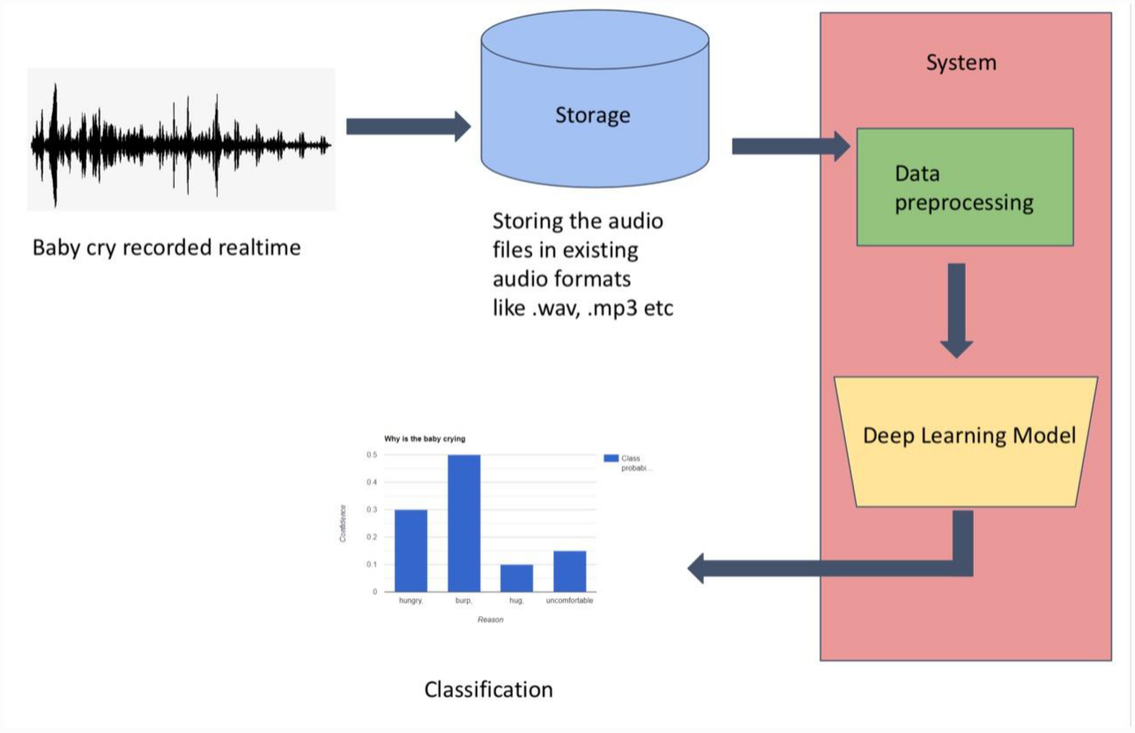
Design
 | Nitte Meenakshi Institute of Technology (AN AUTONOMOUS INSTITUTION AFFILIATED TO VISVESVARAYA TECHNOLOGICAL UNIVERSITY, BELGAUM) PB No. 6429, Yelahanka, Bangalore 560-064, Karnataka Telephone: 080- 22167800, 22167860, Fax: 080 - 22167805
Department of Computer Science and Engineering
AY 2021-2022

Slide 15
ANN Algorithm
 | Nitte Meenakshi Institute of Technology (AN AUTONOMOUS INSTITUTION AFFILIATED TO VISVESVARAYA TECHNOLOGICAL UNIVERSITY, BELGAUM) PB No. 6429, Yelahanka, Bangalore 560-064, Karnataka Telephone: 080- 22167800, 22167860, Fax: 080 - 22167805
Department of Computer Science and Engineering
An ANN is based on a collection of connected units or nodes called artificial neurons, which loosely model the neurons in a biological brain. Each connection, like the synapses in a biological brain, can transmit a signal to other neurons. An artificial neuron receives a signal then processes it and can signal neurons connected to it. The "signal" at a connection is a real number, and the output of each neuron is computed by some non-linear function of the sum of its inputs. The connections are called edges. Neurons and edges typically have a weight that adjusts as learning proceeds. The weight increases or decreases the strength of the signal at a connection. Neurons may have a threshold such that a signal is sent only if the aggregate signal crosses that threshold. Typically, neurons are aggregated into layers. Different layers may perform different transformations on their inputs. Signals travel from the first layer (the input layer), to the last layer (the output layer), possibly after traversing the layers multiple times.
AY 2021-2022

Slide 16
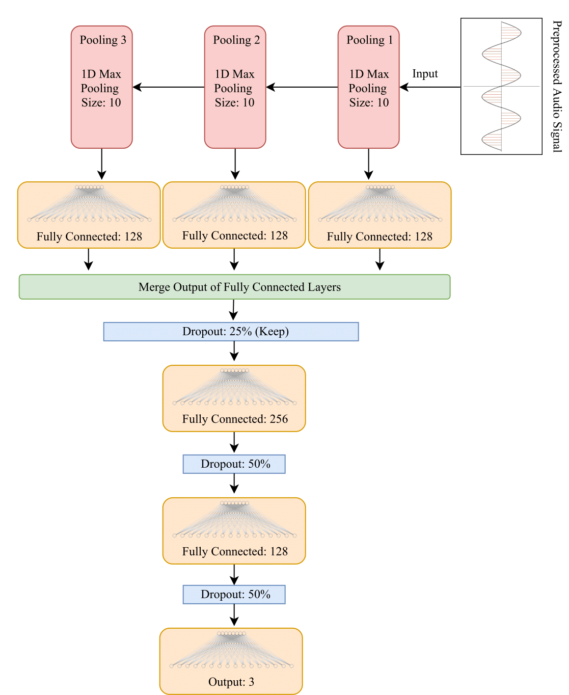
ANN Algorithm
 | Nitte Meenakshi Institute of Technology (AN AUTONOMOUS INSTITUTION AFFILIATED TO VISVESVARAYA TECHNOLOGICAL UNIVERSITY, BELGAUM) PB No. 6429, Yelahanka, Bangalore 560-064, Karnataka Telephone: 080- 22167800, 22167860, Fax: 080 - 22167805
Department of Computer Science and Engineering
AY 2021-2022

Slide 17
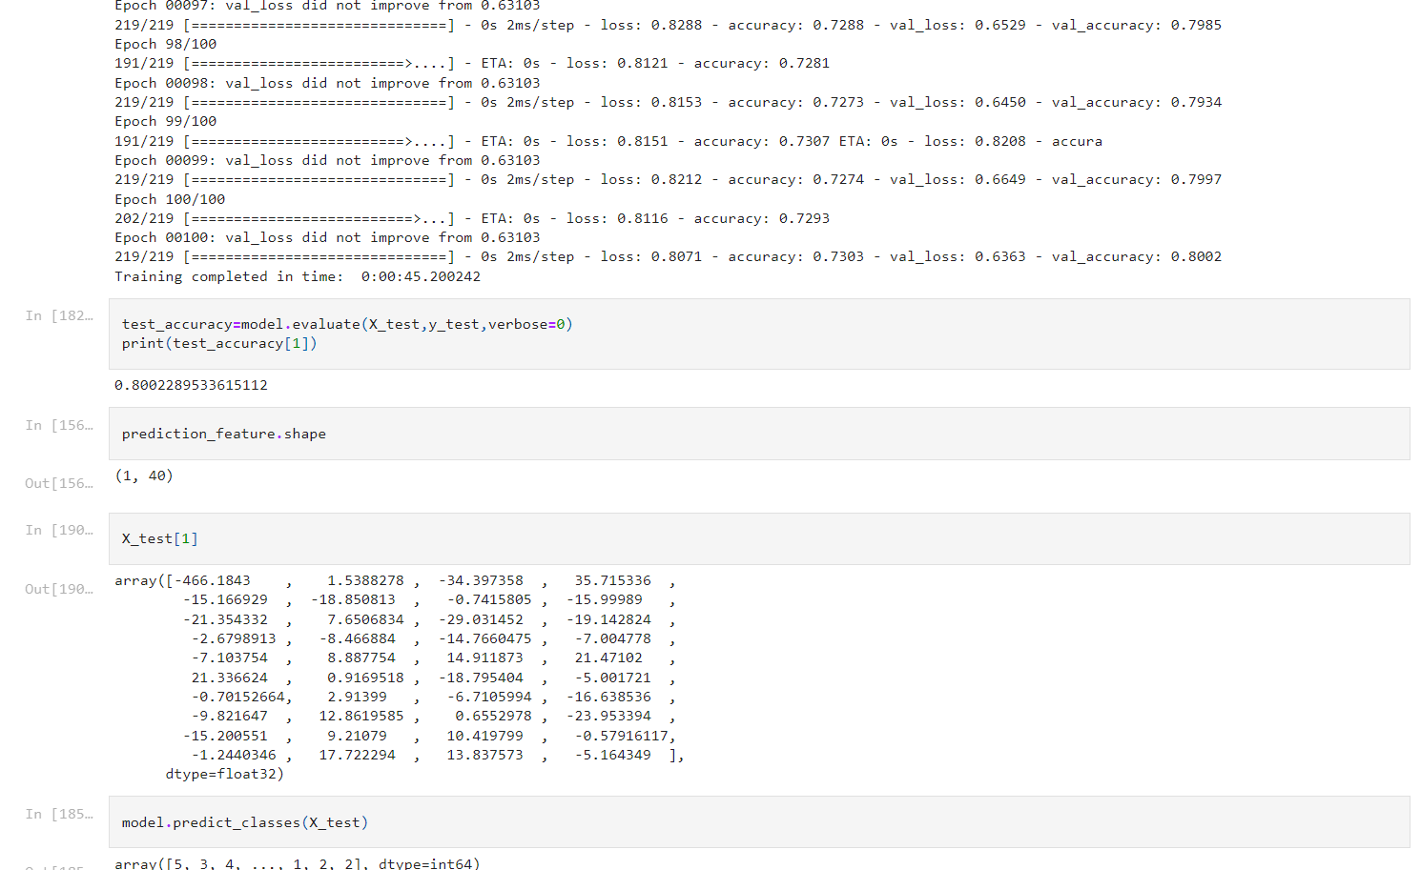
Result
 | Nitte Meenakshi Institute of Technology (AN AUTONOMOUS INSTITUTION AFFILIATED TO VISVESVARAYA TECHNOLOGICAL UNIVERSITY, BELGAUM) PB No. 6429, Yelahanka, Bangalore 560-064, Karnataka Telephone: 080- 22167800, 22167860, Fax: 080 - 22167805
Department of Computer Science and Engineering
AY 2021-2022

Slide 18
Conclusion
 | Nitte Meenakshi Institute of Technology (AN AUTONOMOUS INSTITUTION AFFILIATED TO VISVESVARAYA TECHNOLOGICAL UNIVERSITY, BELGAUM) PB No. 6429, Yelahanka, Bangalore 560-064, Karnataka Telephone: 080- 22167800, 22167860, Fax: 080 - 22167805
Department of Computer Science and Engineering
This report presents important studies in Urban sound analysis and categorisation, giving details and resources for both researchers and medical professionals working in this field. It is demonstrated that the sound classification study is hampered by a lack of database resources. Large datasets with a variety of samples that meet the needs of deep neural networks are essential. To gain superior discriminating ability, the current trend in feature extraction is to build a mixed feature set that takes use of diverse domains. The relevant study findings suggest that combining characteristics can result in a significant improvement. Furthermore, novel neural network-based designs are becoming prevalent.
AY 2021-2022

Slide 19
References
 | Nitte Meenakshi Institute of Technology (AN AUTONOMOUS INSTITUTION AFFILIATED TO VISVESVARAYA TECHNOLOGICAL UNIVERSITY, BELGAUM) PB No. 6429, Yelahanka, Bangalore 560-064, Karnataka Telephone: 080- 22167800, 22167860, Fax: 080 - 22167805
Department of Computer Science and Engineering
https://ieeexplore.ieee.org/document/9358621
https://www.ibm.com/cloud/learn/convolutional-neural-networks/
https://www.kaggle.com/chrisfilo/urbansound8k
https://www.researchgate.net/publication 346659500_Urban_Sound_Classification_Using_Convolutional_Neural_Network_and_Long_Short_Term_Memory_Based_on_Multiple_Features
AY 2021-2022

